Slide 1
ER diagrams
FoodPantry

Slide 2
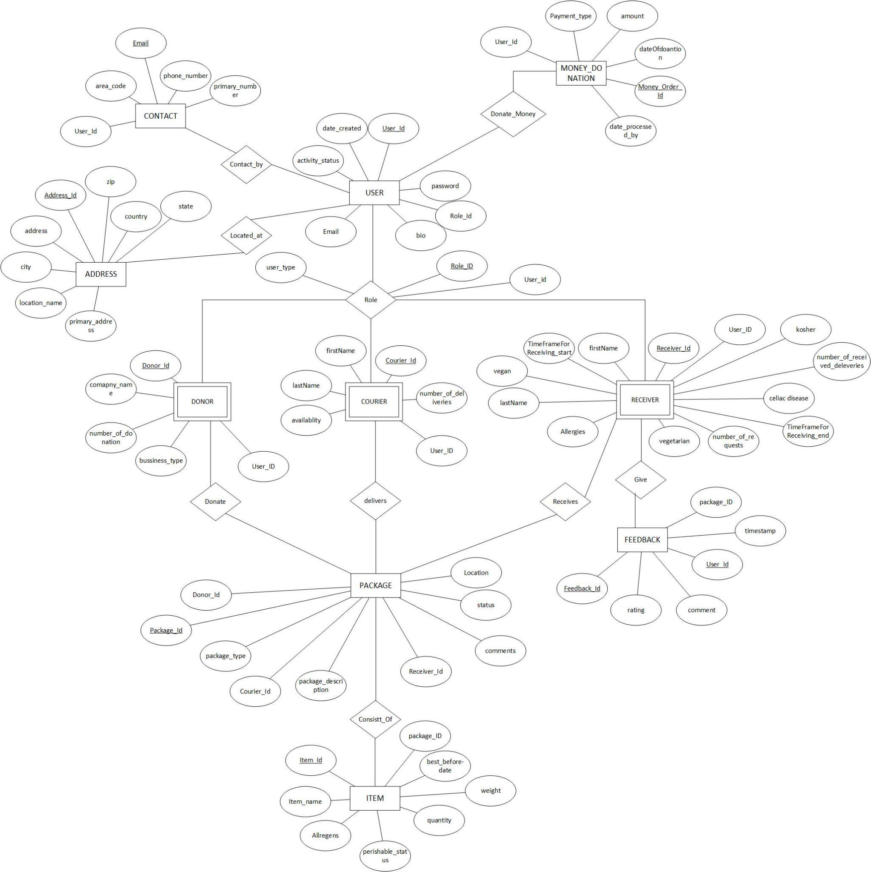
Conceptual ER diagram
Conceptual ERD

Slide 3
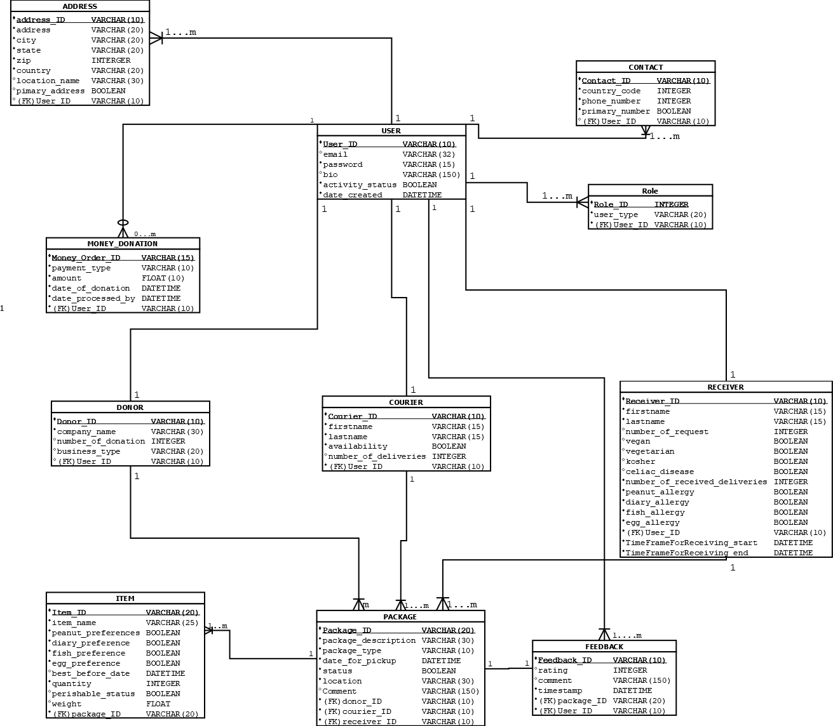
Logical ERD

